Slide 1
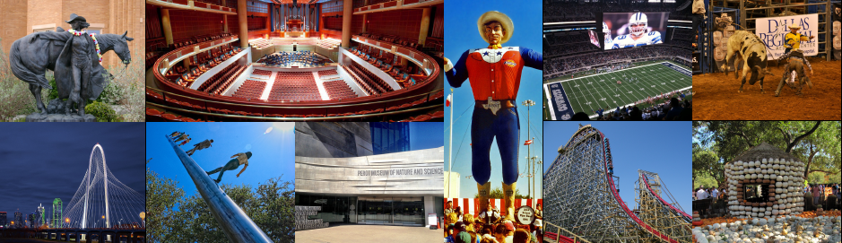
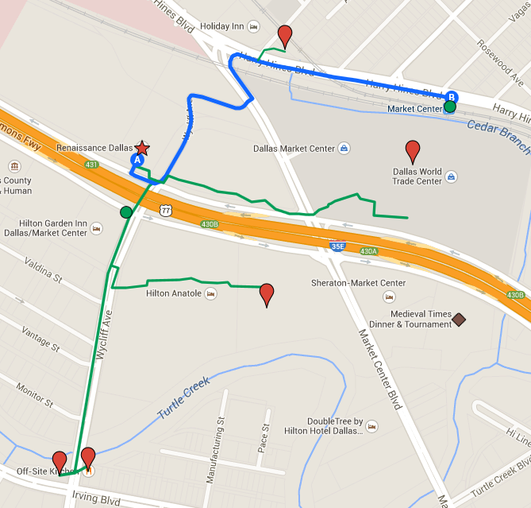
Locality Guide: ACM SIGSPATIAL 2014
Recommended Visits:
The Sixth Floor Museum at Dealey Plaza
Perot Museum of Nature and Science
Dallas Museum of Art
George W. Bush Presidential Library
Fort Worth Stockyard
10 Minute
Walking Radius
Original Market Diner
DART Light Rail Station
Renaissance Hotel
World Trade Center Food Court and Fountain Cafe
Bus 49 to downtown
SĒR Steak + Spirits (Anatole Hotel)
Medieval Times Dinner & Tournament
Off-Site Kitchen
Slow Bone (BBQ)
Dallas Downtown
Hotel will provide food stations (e.g. taco stand and buffet )for lunches T-Th.
Arrangement for parking at the hotel is at the special rate of $10 per day.

